Slide 1


FPT SOFTWARE
Machine Learning Fundamentals
10/02/18

Slide 2
Machine Learning Fundamentals
Lecture 3: Unsupervised Learning
Outline:
The Different Between Supervised Learning and Unsupervised Learning
Clustering and Dimensionality Reduction
Recommender Systems
Project

Slide 3
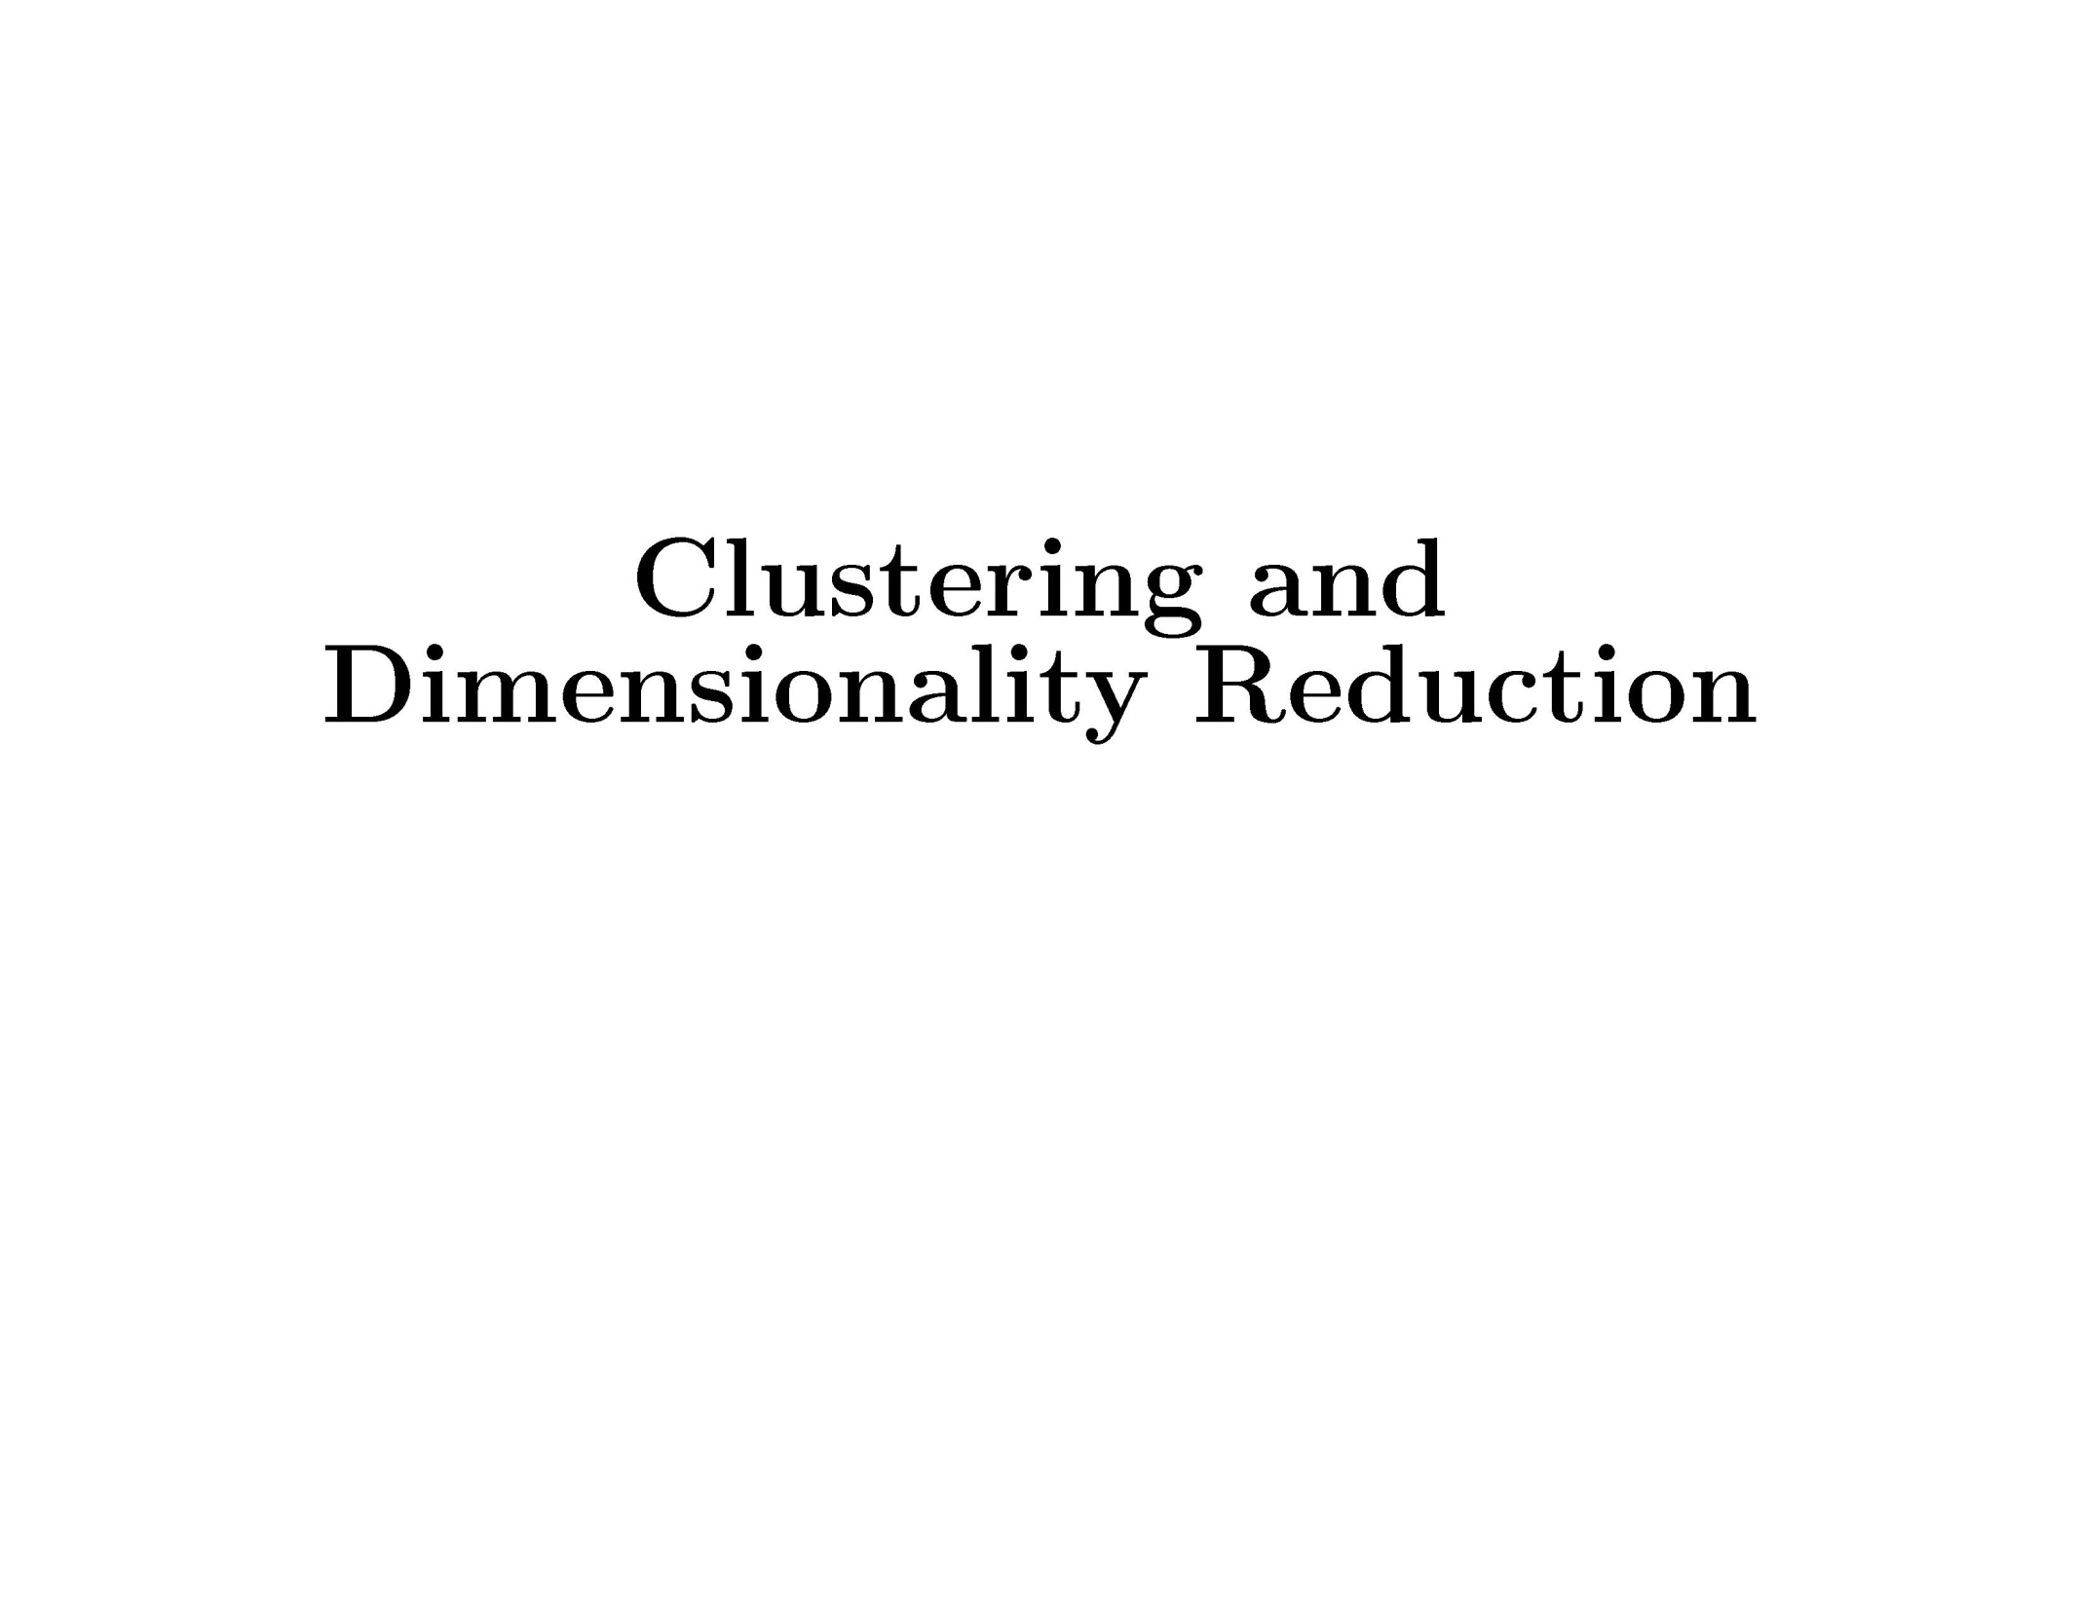
Clustering and Dimensionality Reduction

Slide 4
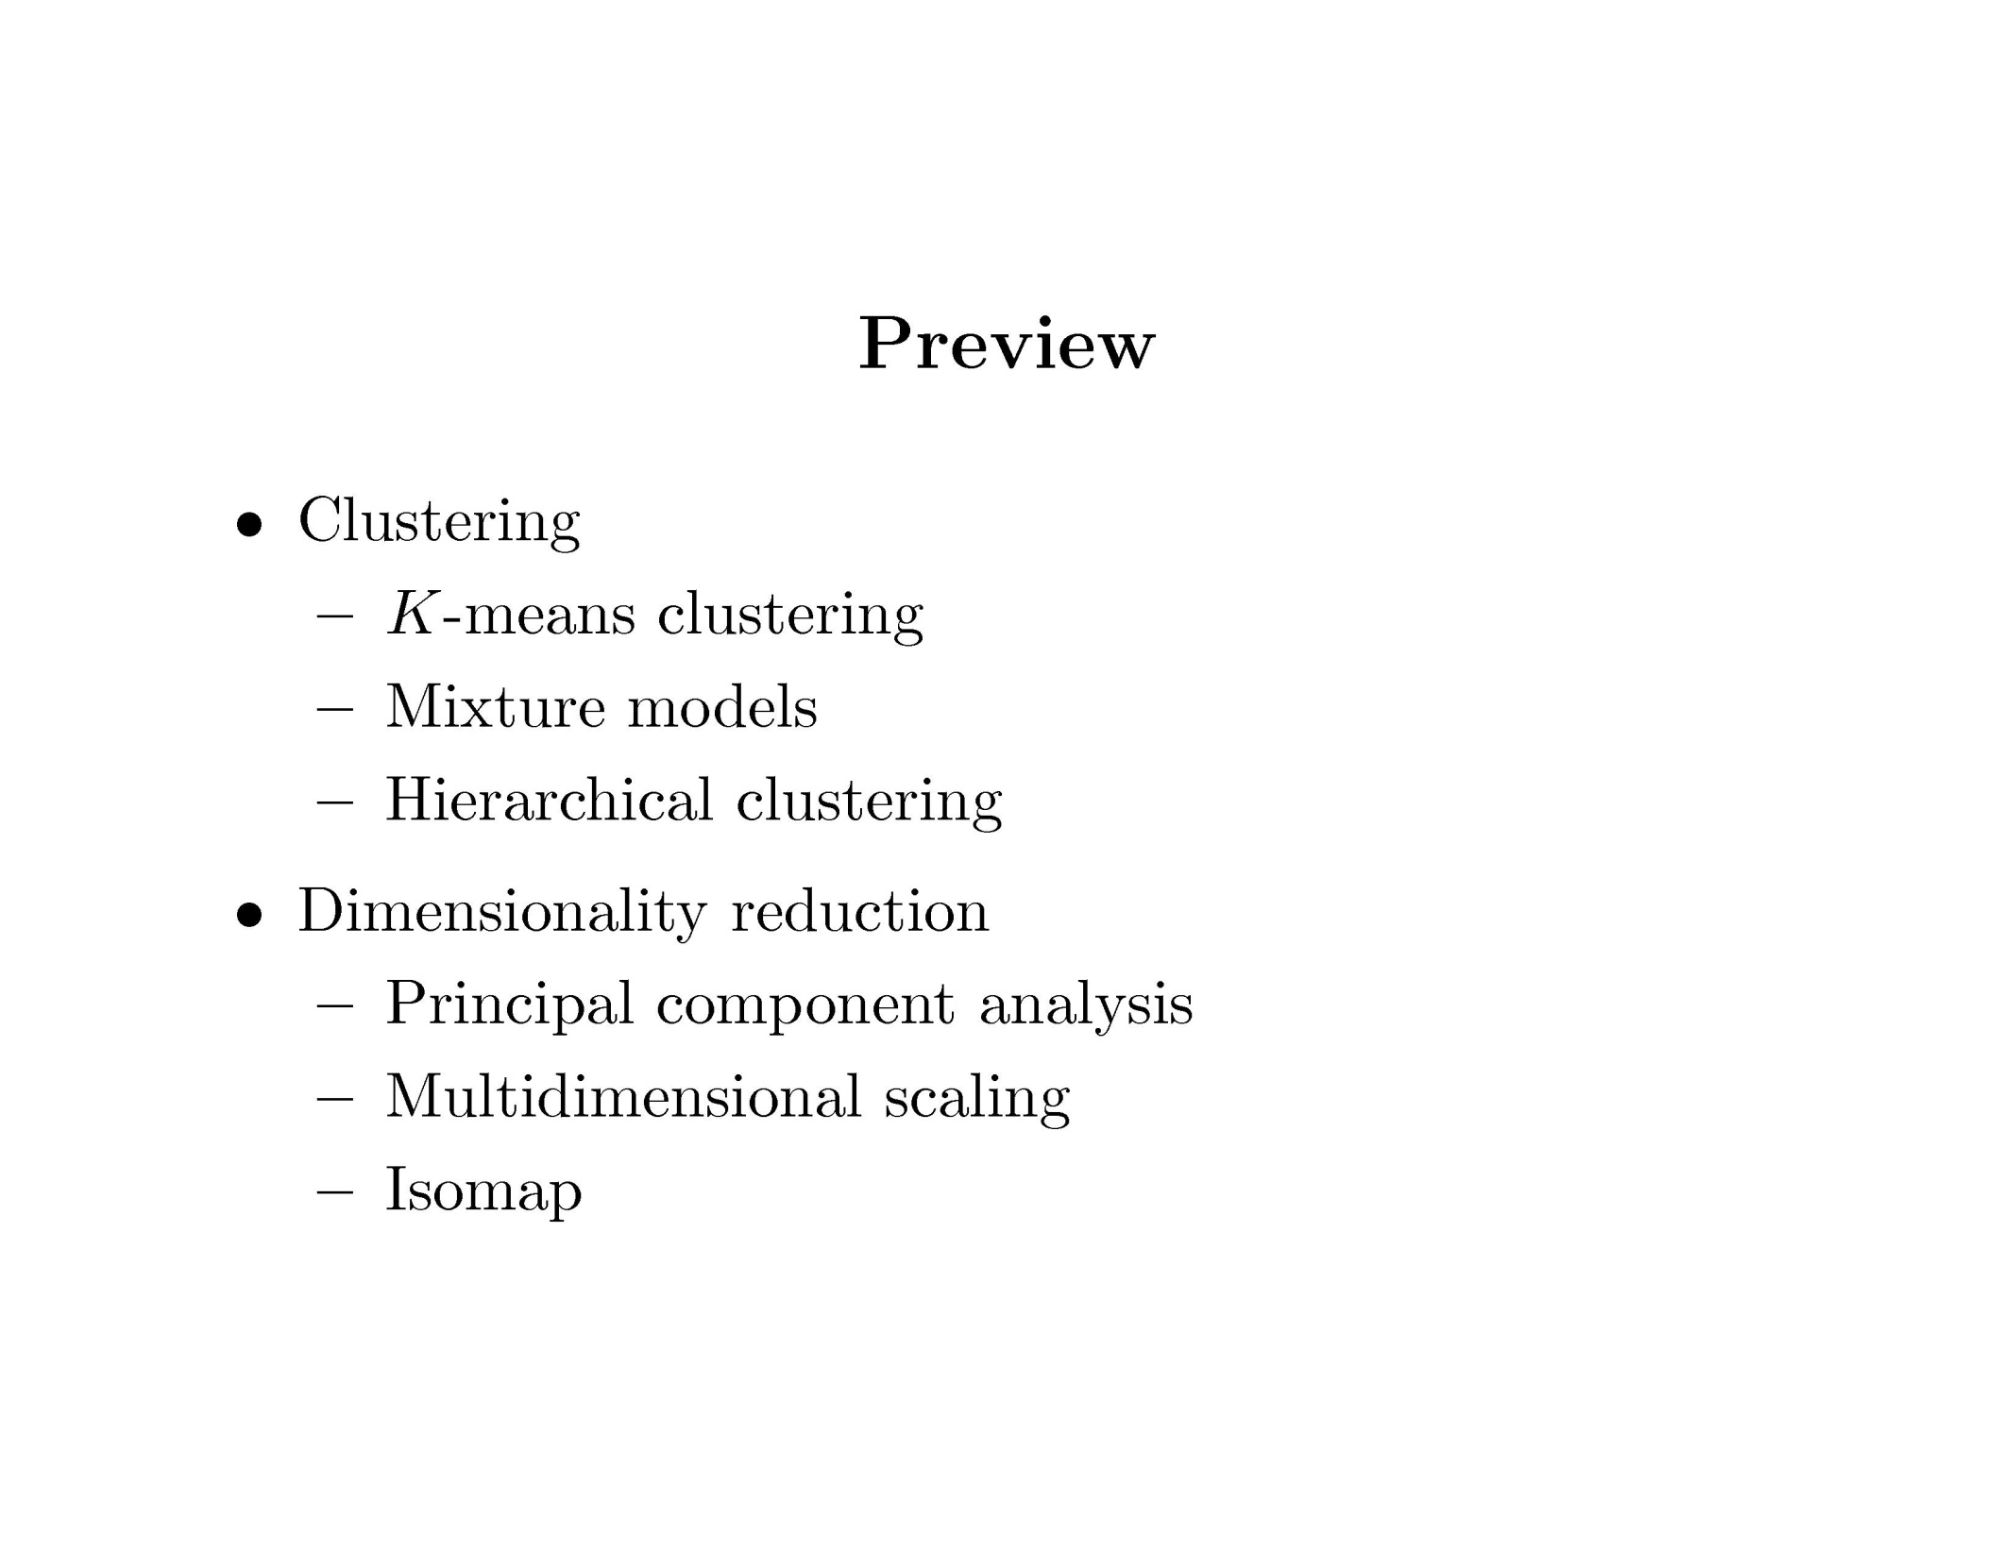
Clustering and Dimensionality Reduction

Slide 5
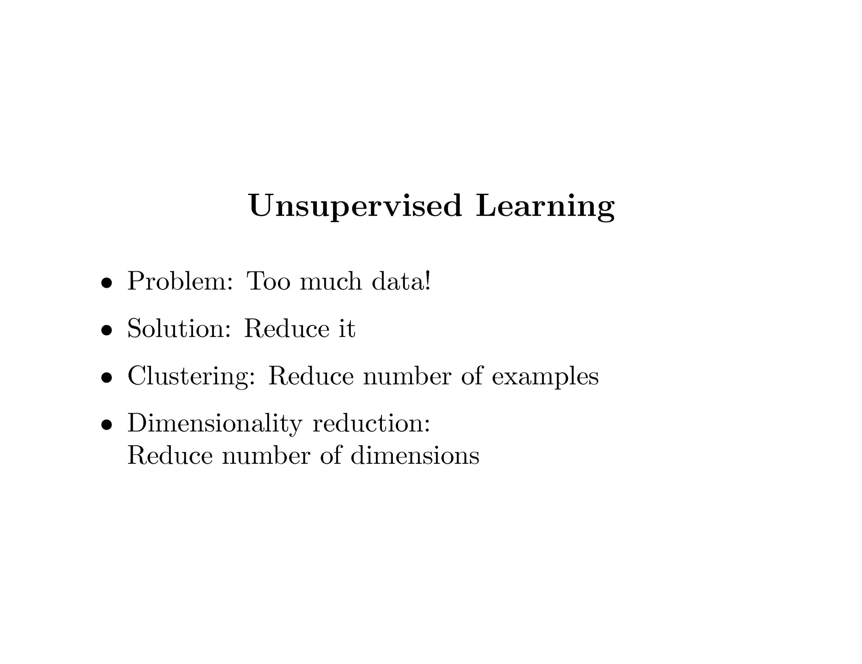
Clustering and Dimensionality Reduction

Slide 6
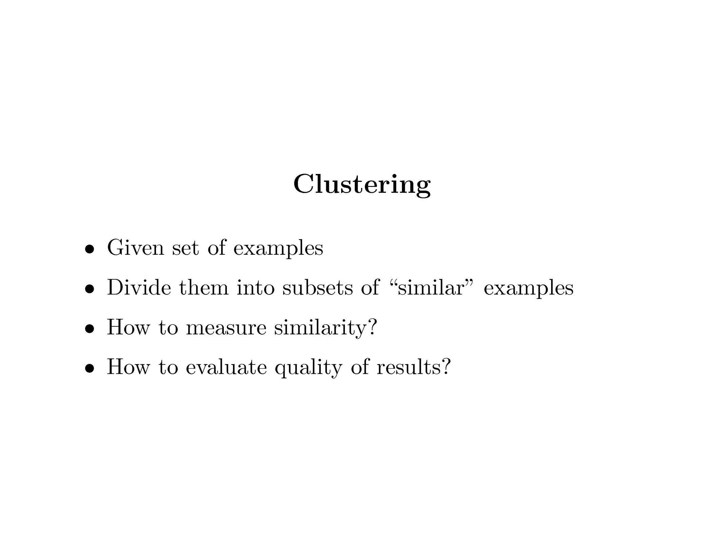
Clustering and Dimensionality Reduction

Slide 7
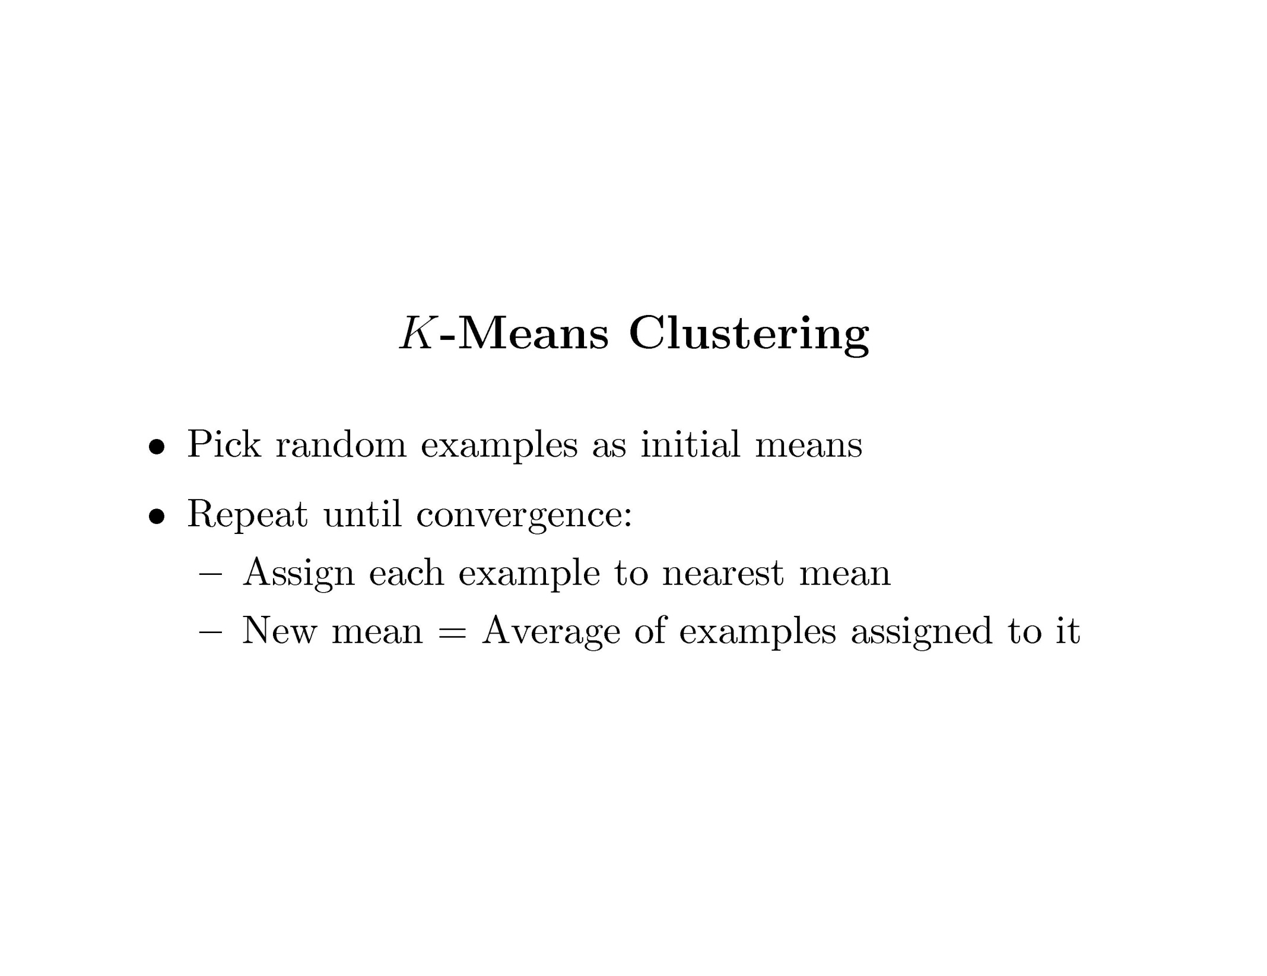
Clustering and Dimensionality Reduction

Slide 8
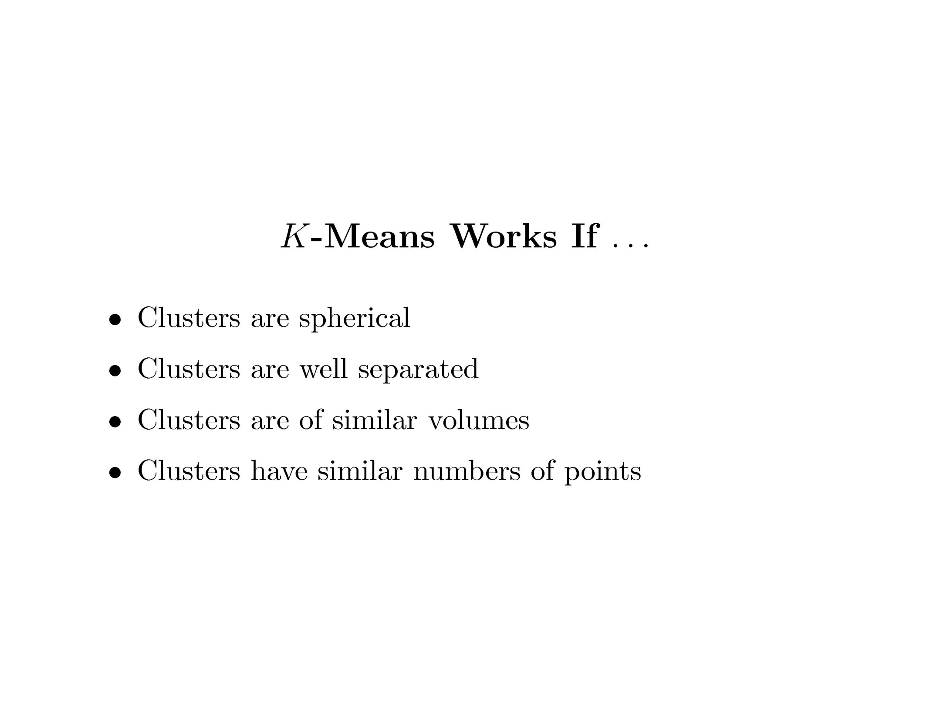
Clustering and Dimensionality Reduction

Slide 9
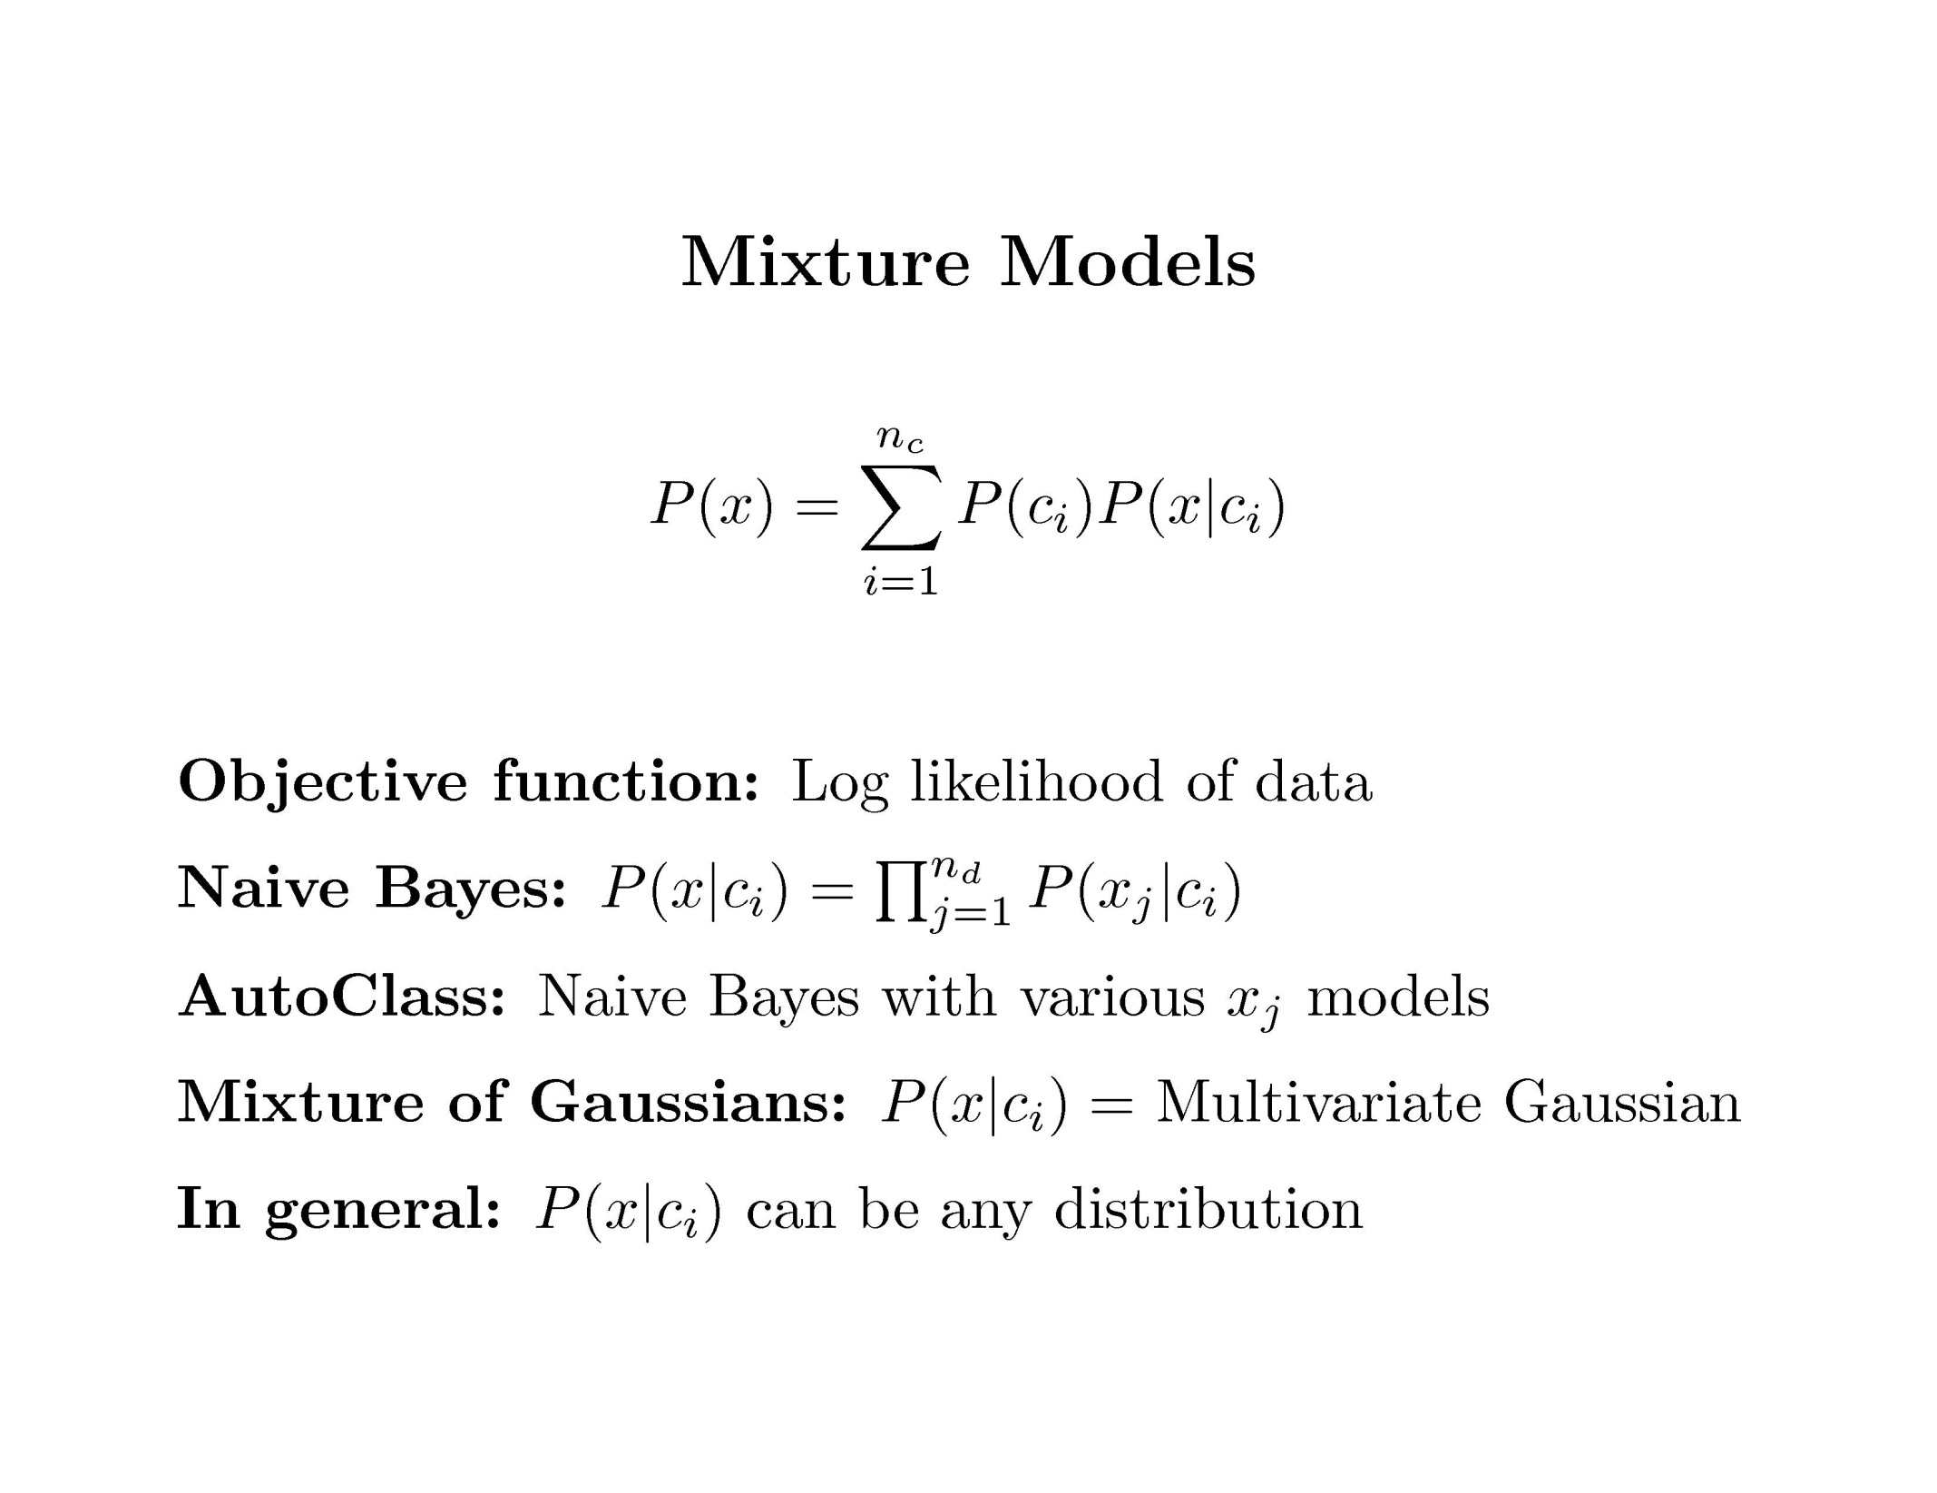
Clustering and Dimensionality Reduction

Slide 10
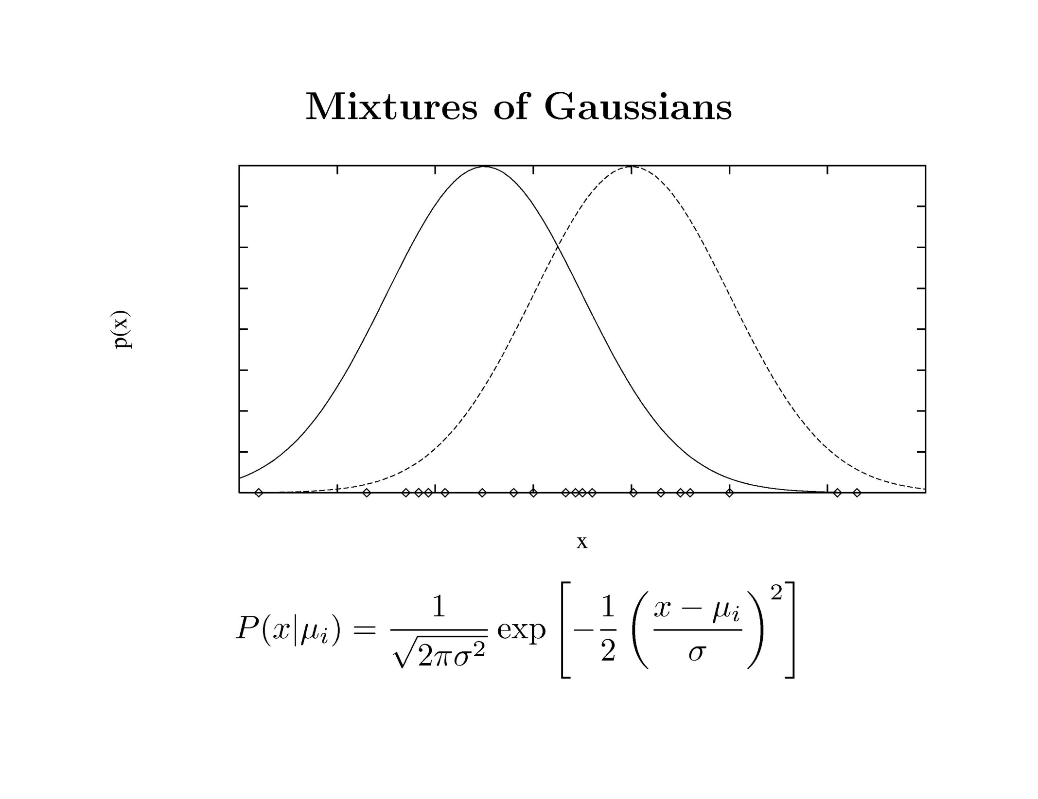
Clustering and Dimensionality Reduction

Slide 11
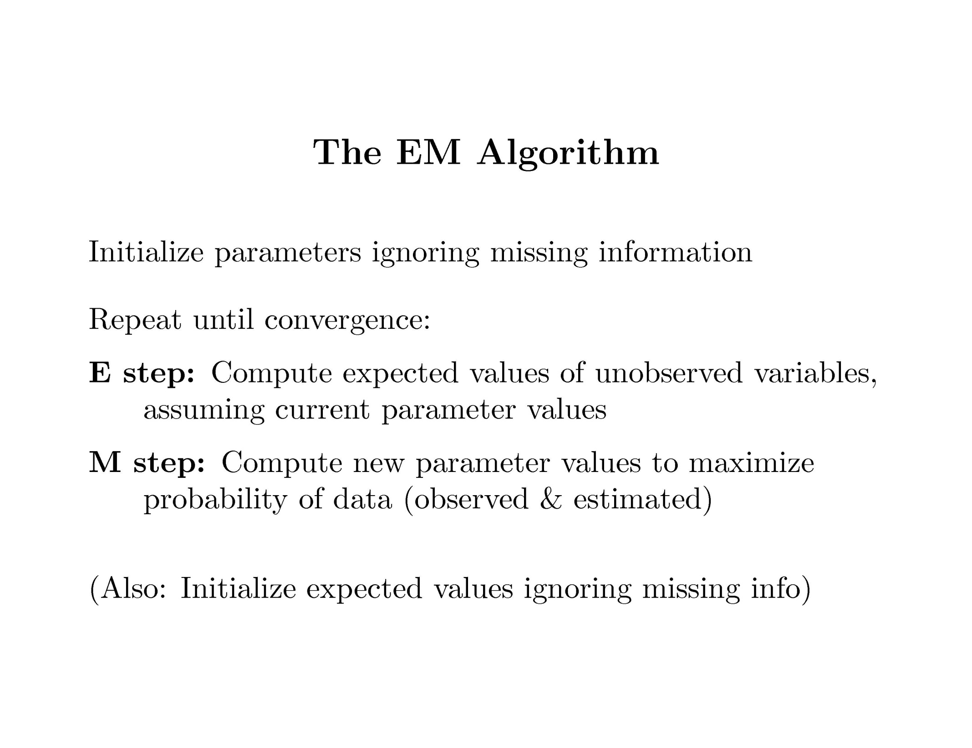
Clustering and Dimensionality Reduction

Slide 12
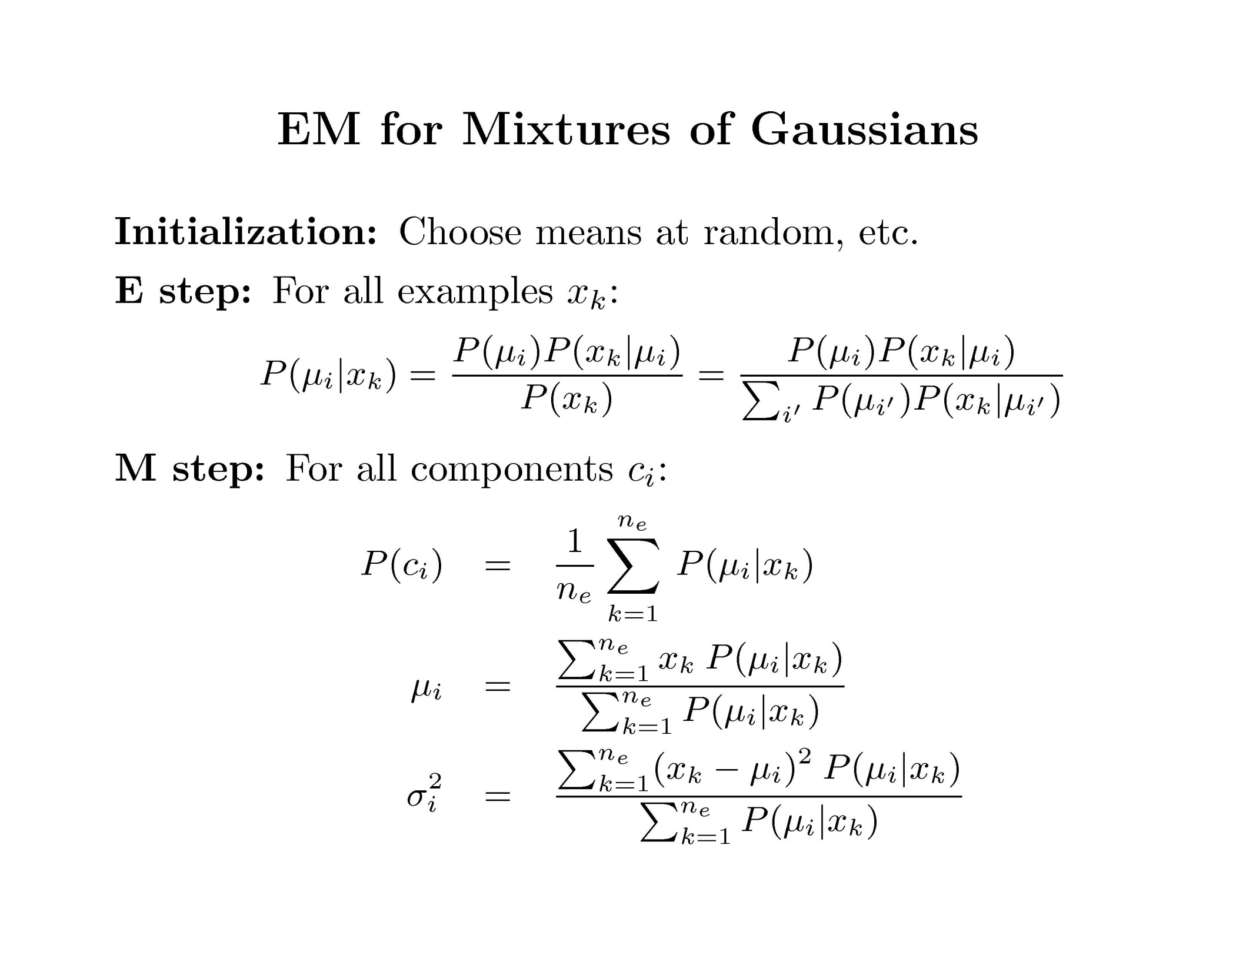
Clustering and Dimensionality Reduction

Slide 13
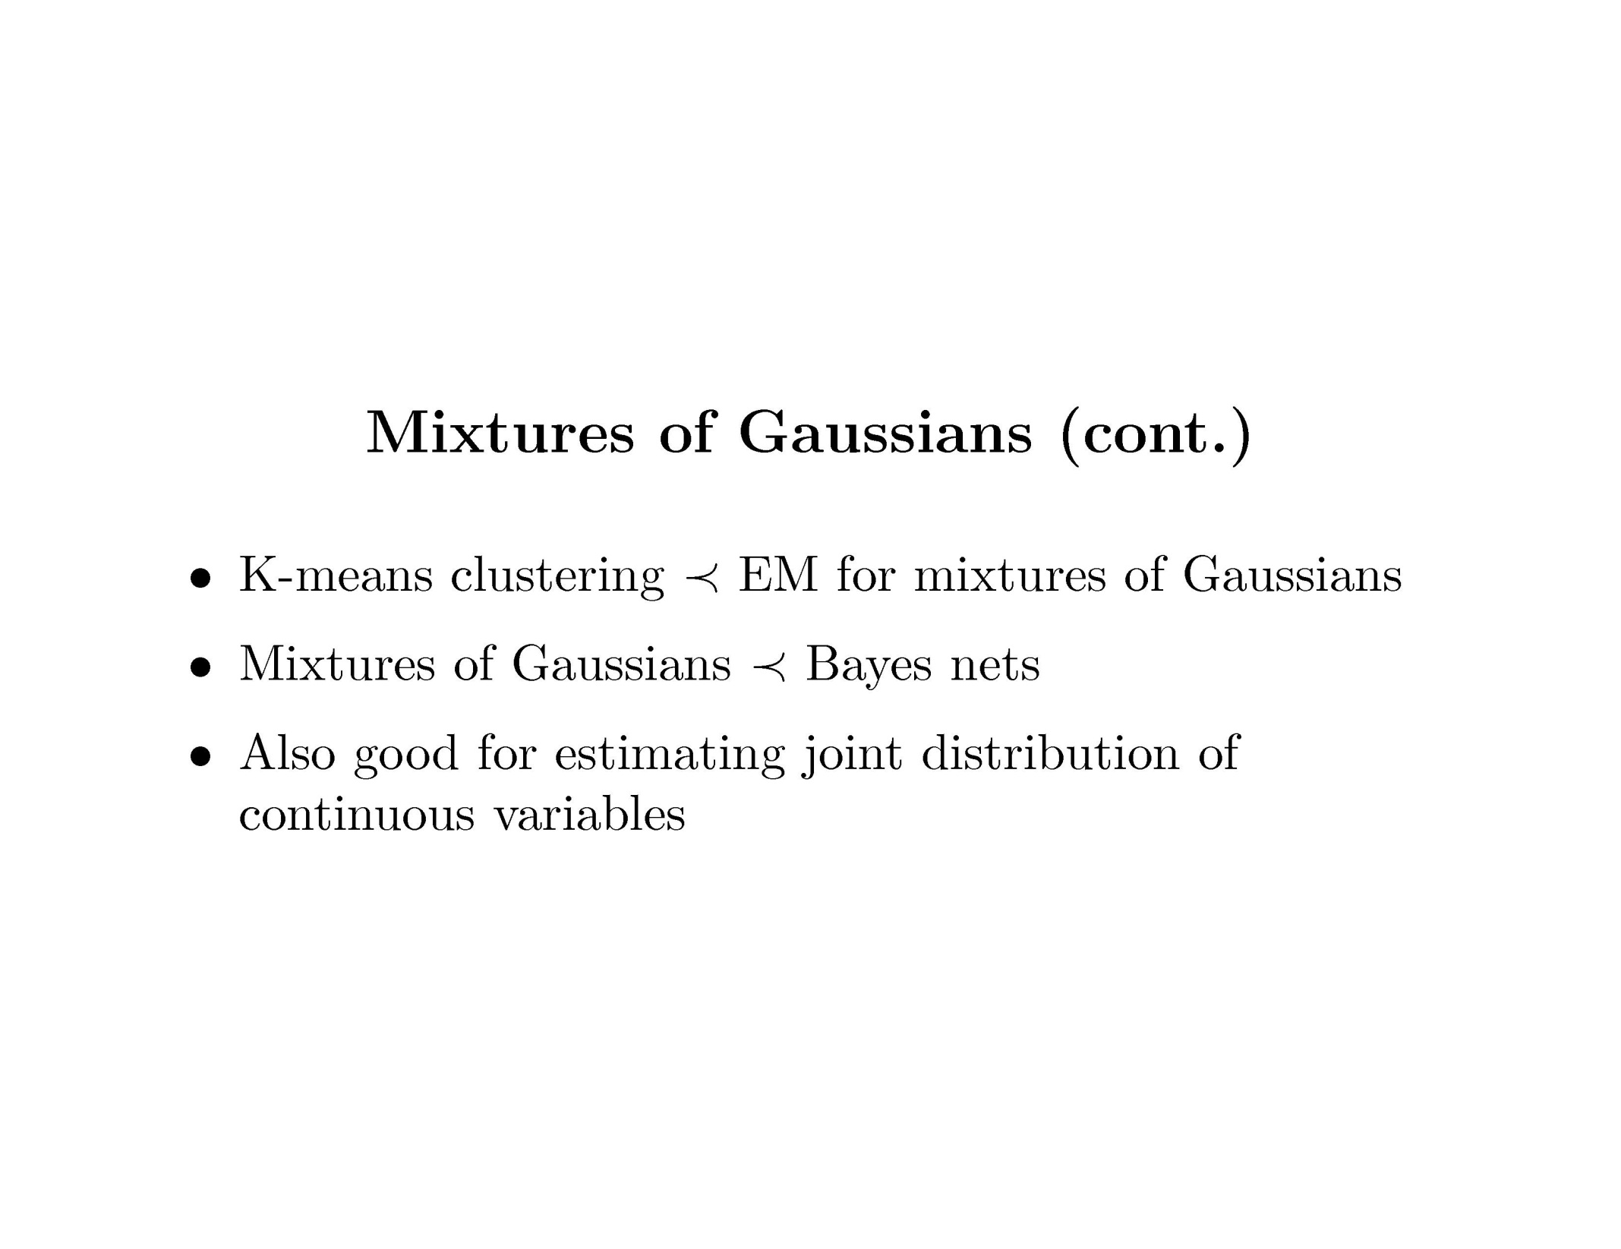
Clustering and Dimensionality Reduction

Slide 14
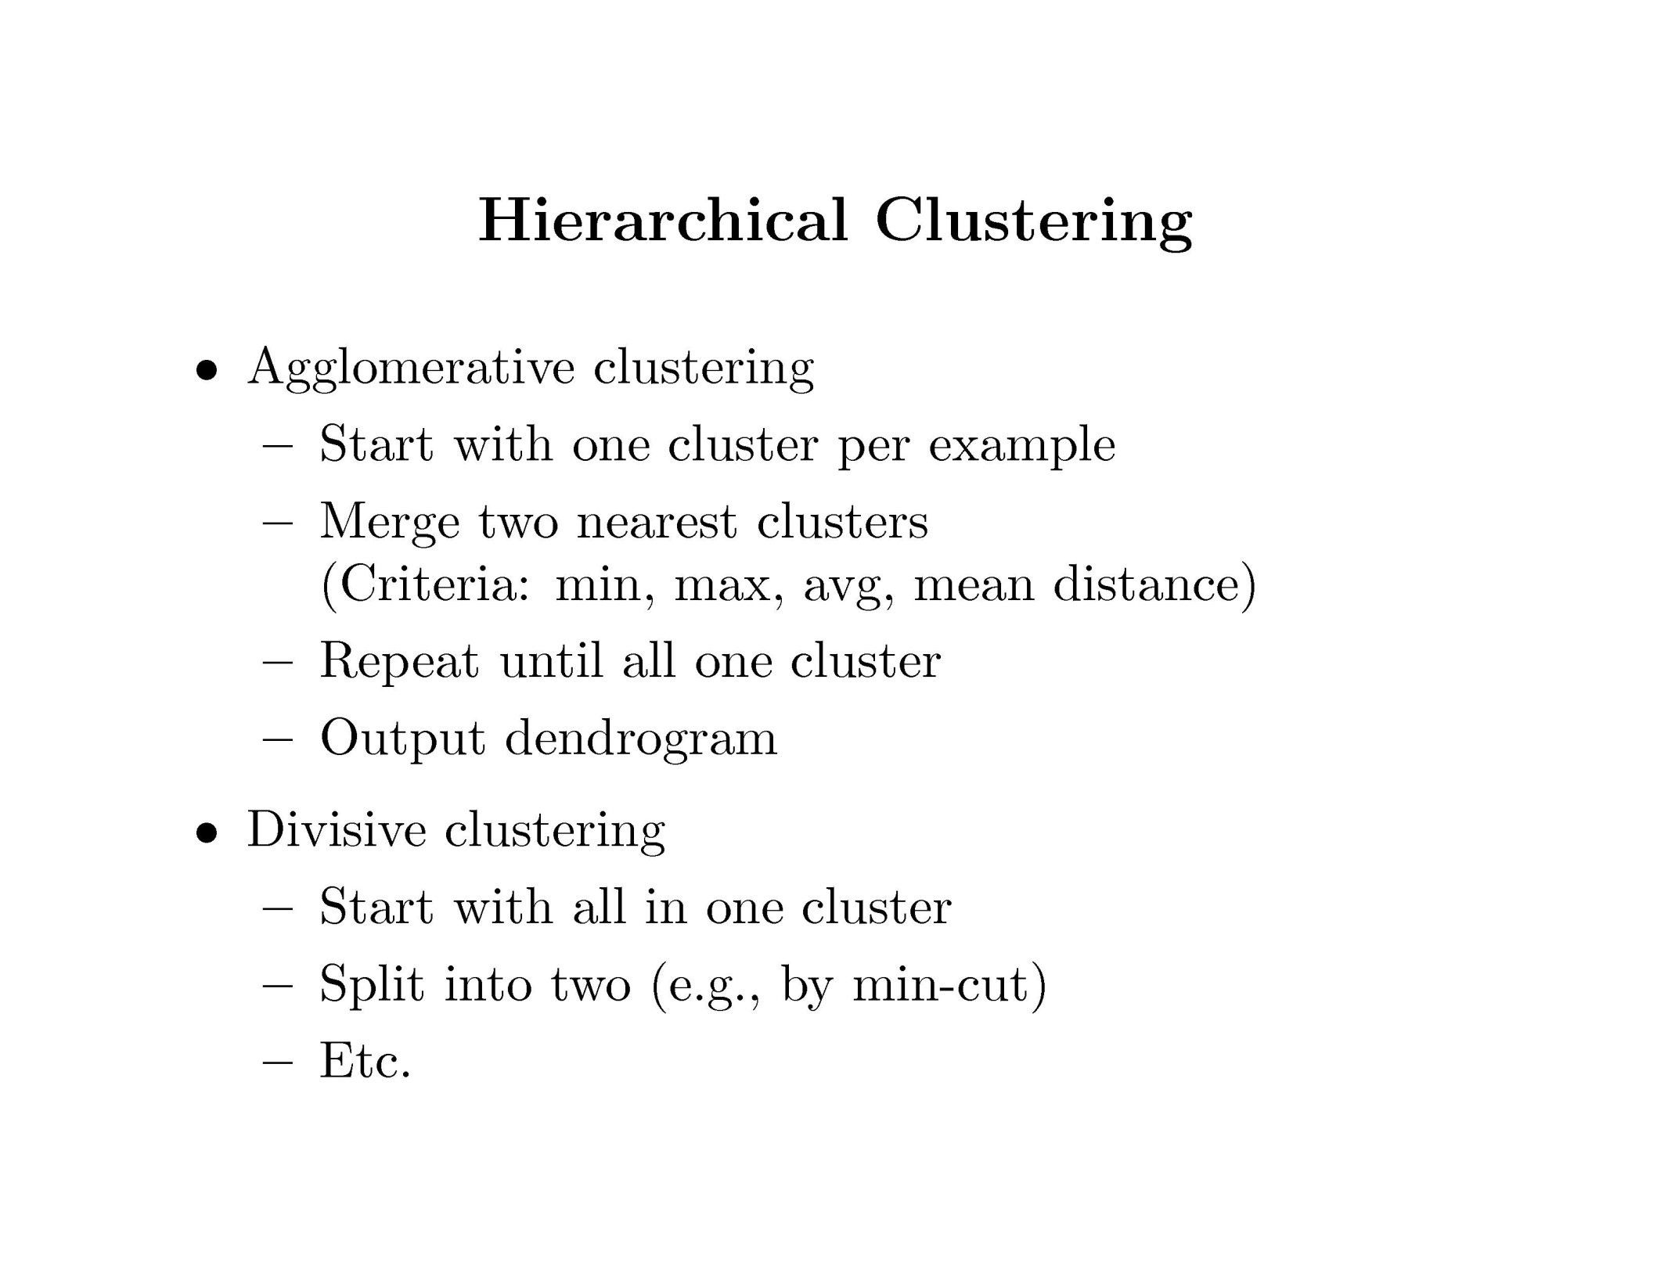
Clustering and Dimensionality Reduction

Slide 15
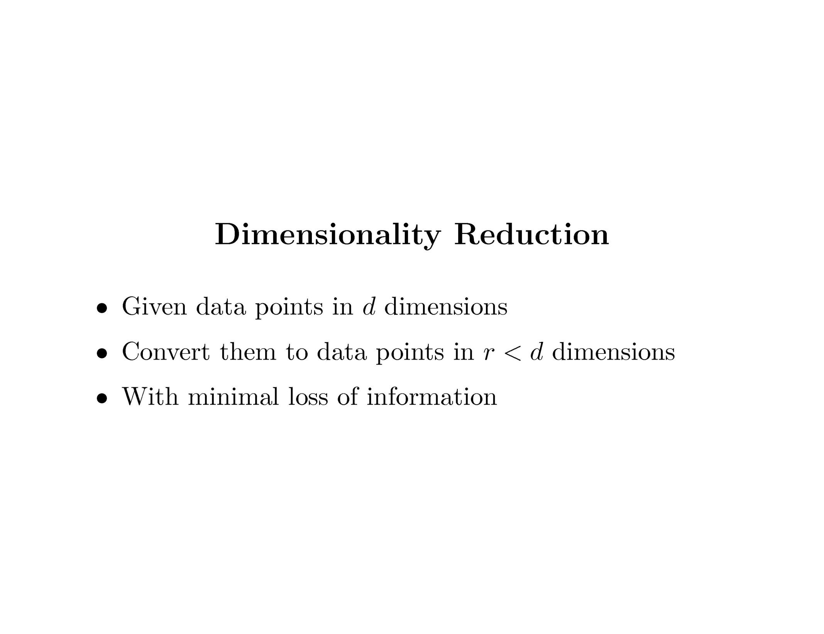
Clustering and Dimensionality Reduction

Slide 16
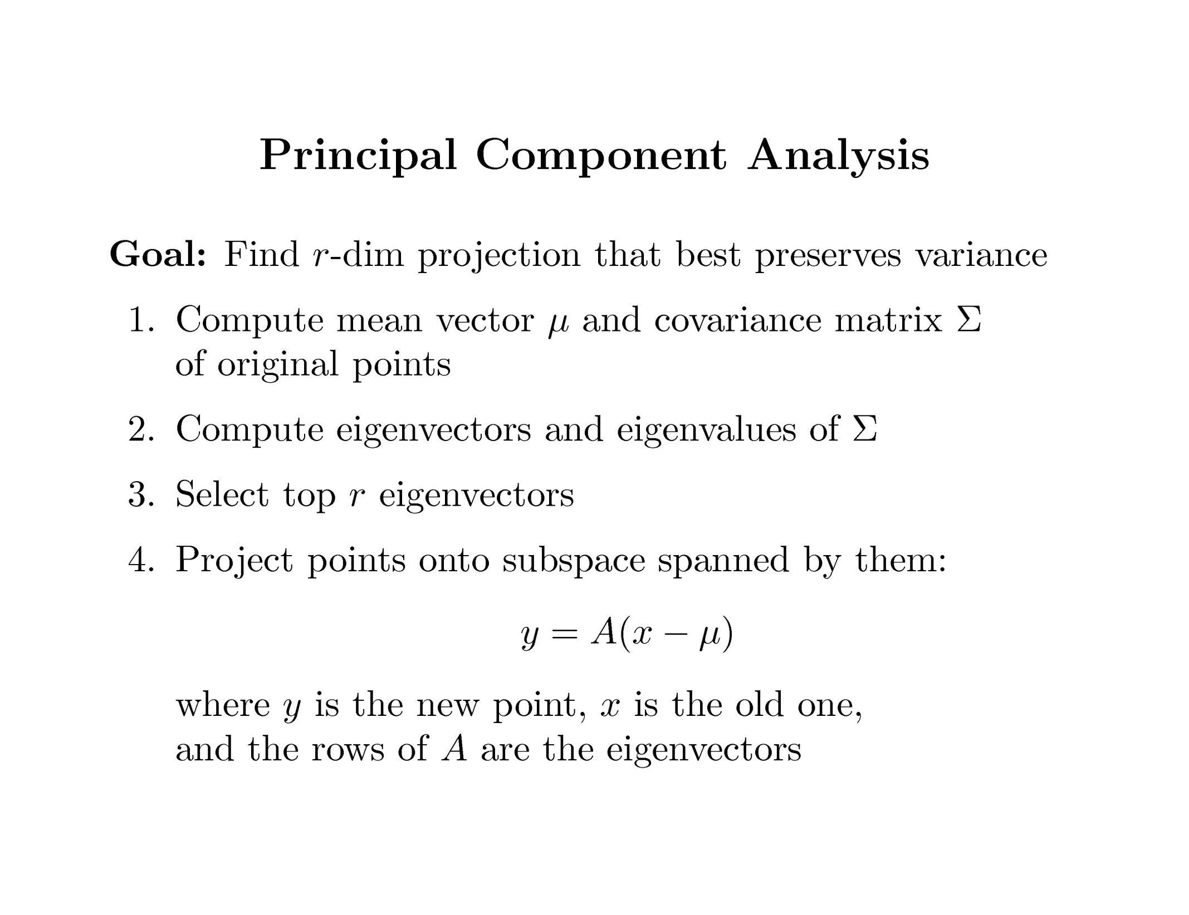
Clustering and Dimensionality Reduction

Slide 17
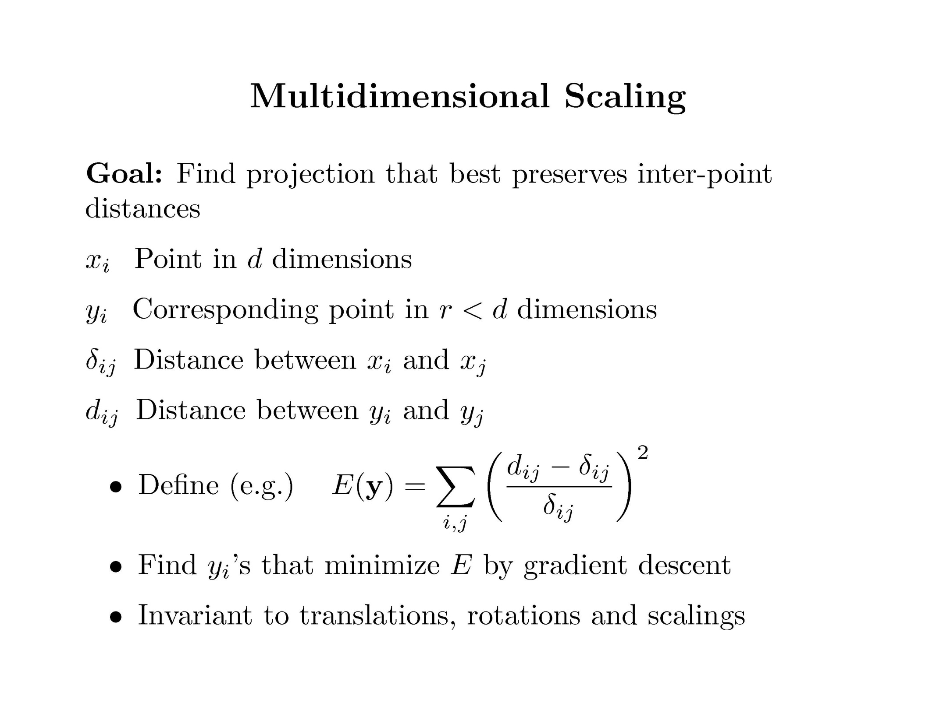
Clustering and Dimensionality Reduction

Slide 18
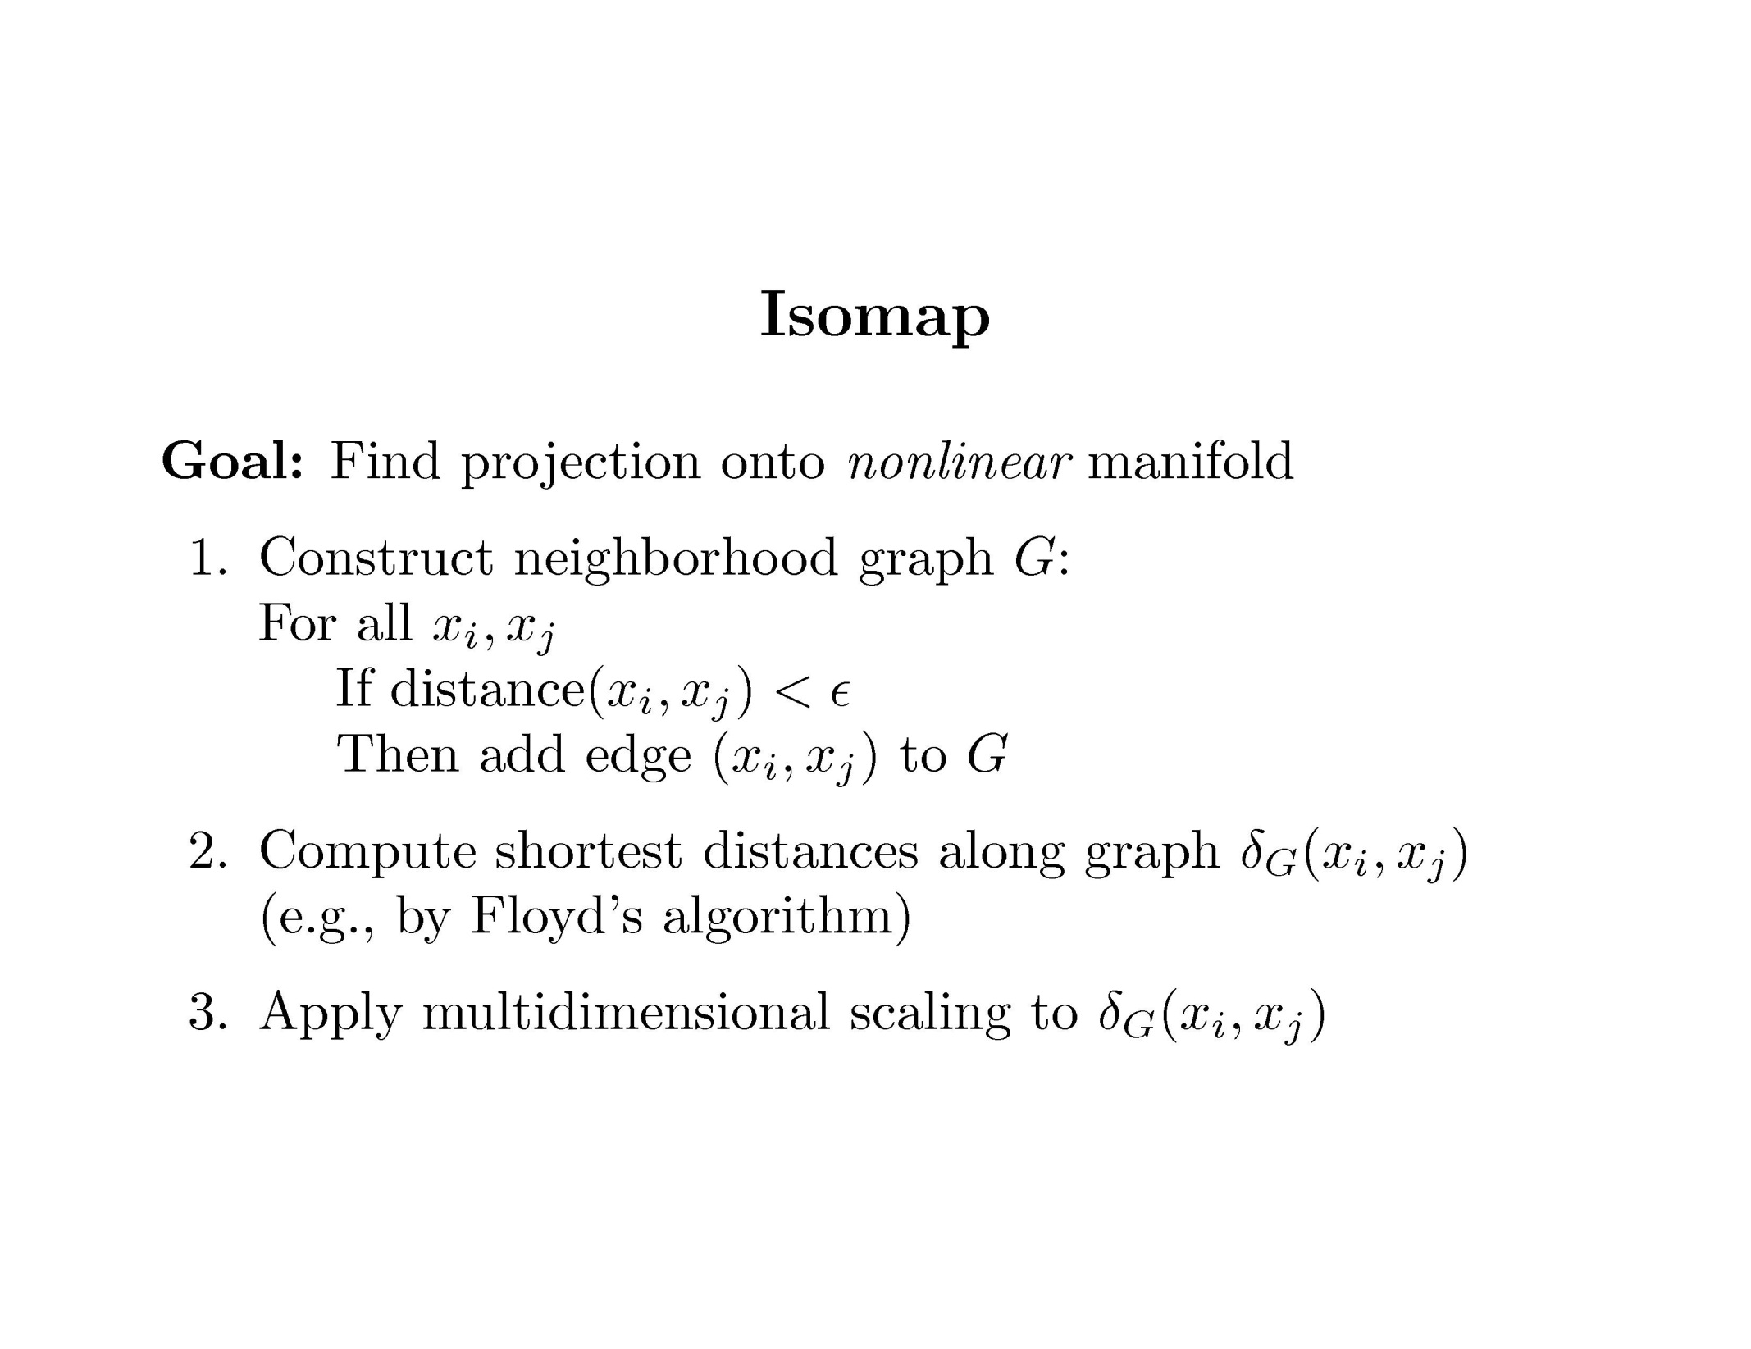
Clustering and Dimensionality Reduction

Slide 19
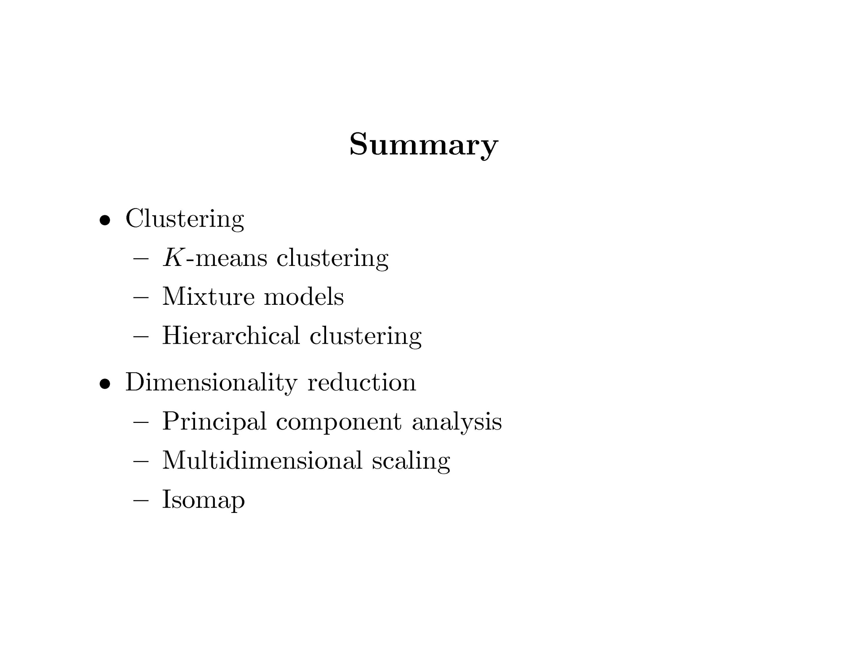
Clustering and Dimensionality Reduction

Slide 20
Clustering and Dimensionality Reduction
Exercise

